Slide 1


Advanced Methods in Data Science - DTSC104
Milestone 1
Label/cluster the dataset using the GA and the K-Mean clustering algorithms
Introduced by
Omnia Gad
Nardeen Shaheer
Nourhan Reda Abdelall

Slide 2
Description of data :
Airlines Dataset Inspired in the regression dataset from Elena Ikonomovska. The task is to predict whether a given flight will be delayed, given the information of the scheduled departure.
Flight --> Flight ID
Time --> Time of departure
Length --> Length of Flight
Airline --> Airline ID
AirportFrom --> Which airport the flight flew from
AirportTo --> Which airport the flight flew to
DayOfWeek --> Day of the week of the flight
Class --> Delayed (1) or not (0)
dataset["Time"].min() is 10.0 and dataset["Time"].max() is 1439.0. Since there are 1440 minutes in 24 hrs, I assume that this is the number of minutes in 24 hrs, and the 1439.0 flights are 23:59.
believe that number 1 stands for 'monday' so 7 would be Sunday!

Slide 3
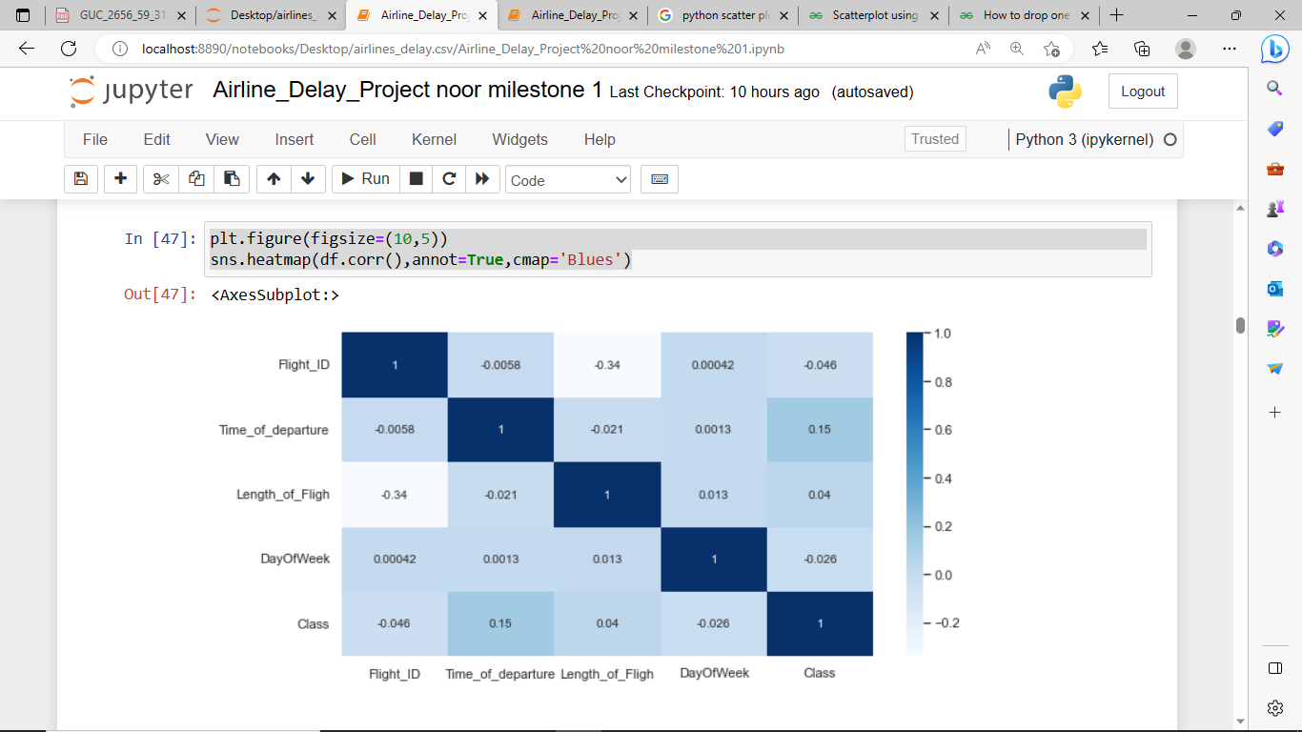
EDA and Data preprocessing:
This data exposed to a slight cleaning and drop of unique values so it’s not biased along any feature .
The heat map as shows the correlation between features
If there are 2 features to choose we ‘ll choose [Time of departure] , [DayOfWeek] as the correlation between them is week
As well encoding and normalization of the data is part of preprocessing so the data is ready for algorithms

Slide 4
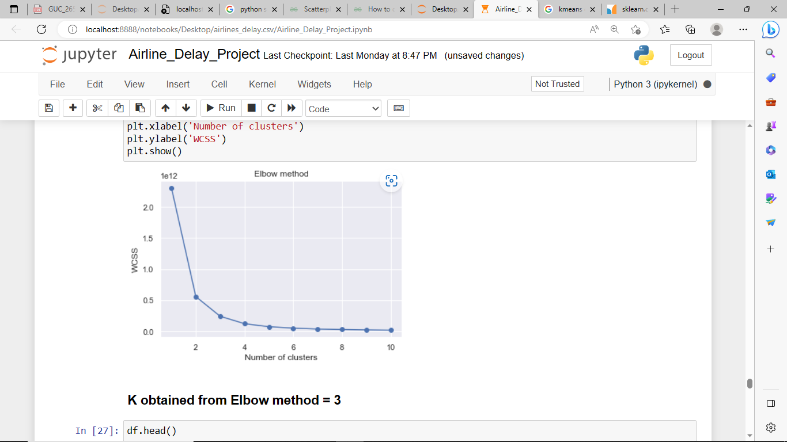
Kmean algorithms :
choosing the correct number of clusters by using elbow technique ; it gives 3 clusters but we use 2 clusters as the classes we want to predict is 2
data points are assigned to its cluster based on the least euclidean distance between the points and cluster centroids and the centroids are recalculated by the mean of the data points assigned to the cluster
The conclusion is ;
the time consumes for this algorithm is 4h 25min 54s
the mean square error is 0.4858

Slide 5
Genetic algorithm clustering:
encoded in the form of strings (called chromosomes). A collection of such strings is called a population. Initially, a random population is created, which represents different points in the search space. An objective and fitness function is associated with each string that represents the degree of goodness of the string. Based on the principle of survival of the fittest, a few of the strings are selected and each is assigned a number of copies that go into the mating .
parameters;
population_size = 10
number_of_generaions = 5
number_of_clusters = 2
number_of_samples = data_GA.shape[0]
p_e = 0.2
p_c = 0.6
p_m = 1 - p_e - p_c
The conclusion is ;
the time consumes for this algorithm is 1h 45min 23s
the mean square error is 0.51412

Slide 6
Comparison between Kmeans and GA algorithm:
 | K-means algorithm | Genetic algorithm
Mean square error | 0.485887 | 0.514127
Computational time | 4h 25min 54s | 1h 45min 41s

